Slide 1



Sportsync
Notes:
Here is the overview of our SportSync.

Slide 2
Agenda
Project Motivation
Software Engineering Object Design
Software Engineering Design Patterns
Notes:
I will start off by presenting to you our project motivation. Software Engineering Object Design and Design patterns used in our website will be done later on.

Slide 3


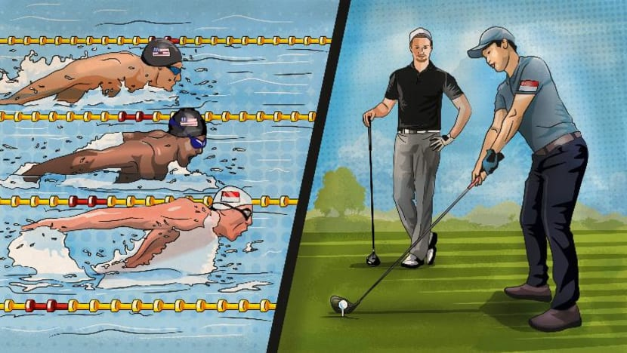


Project motivation
Create innovative application that exploit the publicly available government to change the ways we live, learn and work.
Valuable contributor to the advancement of society as part of Smart Nation Initiative
Notes:
Based on the requirements, our team wants to create an innovative application that exploit the publicly available government API to change the ways we live, learn and work. In other words, we wishes to be part of our Singapore’s Smart Nation Initiative and be a valuable contributor to the advancement of our society.

Slide 4



Project motivation
One Stop Booking of Sports Coaching Services
Objective
Simplify Training Session Booking
Community Building
Seamless Transport Integration
Notes:
Therefore, we have thought of an One Stop Booking of Sports Coaching Services which has very similar concept to Carousell, Taobao and Meituan

Slide 5


Sportsync Observer Pattern Selective Notification
🞂​ SportSync notifies those who book a particular listing services (i.e. interests)
SportSync YourAccount
loop [for each account of a listing]
update(listing)
getData(listing)
subject 1
details
SportSync
notify(Listing)
getData(Listing) :Details
*
observers
YourAccount
update(Listing)
for each account in observers of a particular Listing account.update(Listing);
subject.getData(Listing); yourProcess(details);
5
Notes:
We use Observer Pattern in our website and is roughly demonstrated here in a sequence and class diagrams. As a Subject, I want to let whoever book my listing know the latest listing change and as an Observer, I want to be able to book the listing freely and be notified if there is any change. Meaning to say that the Loose coupling concept here is a benefit for both sides! In this manner, the abstract coupling between Subject and Observer supports broadcast communication and enables reusability of subjects and observers independently of each other.

Slide 6
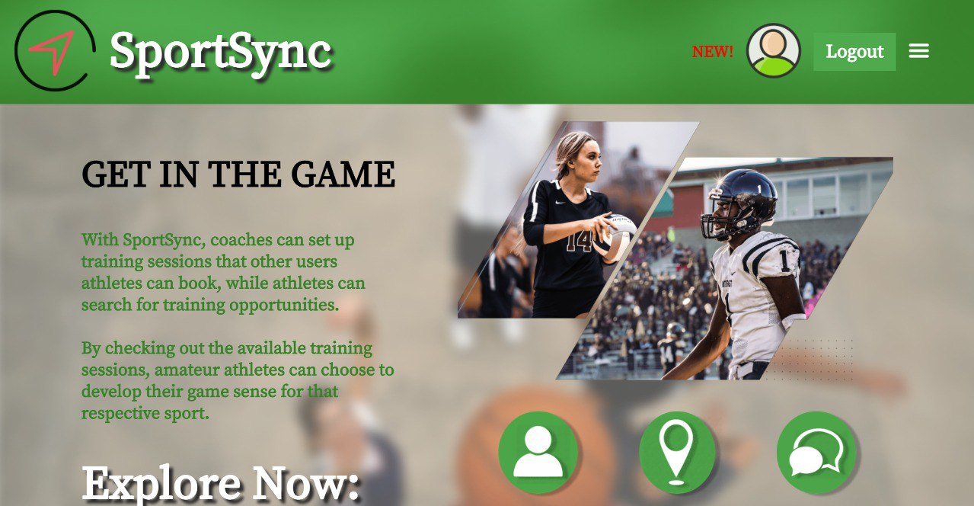
Observer Pattern
Notes:
So here is the example on our website, where we can see that the coaches are able to get updates when an athlete book a listing.

Slide 7
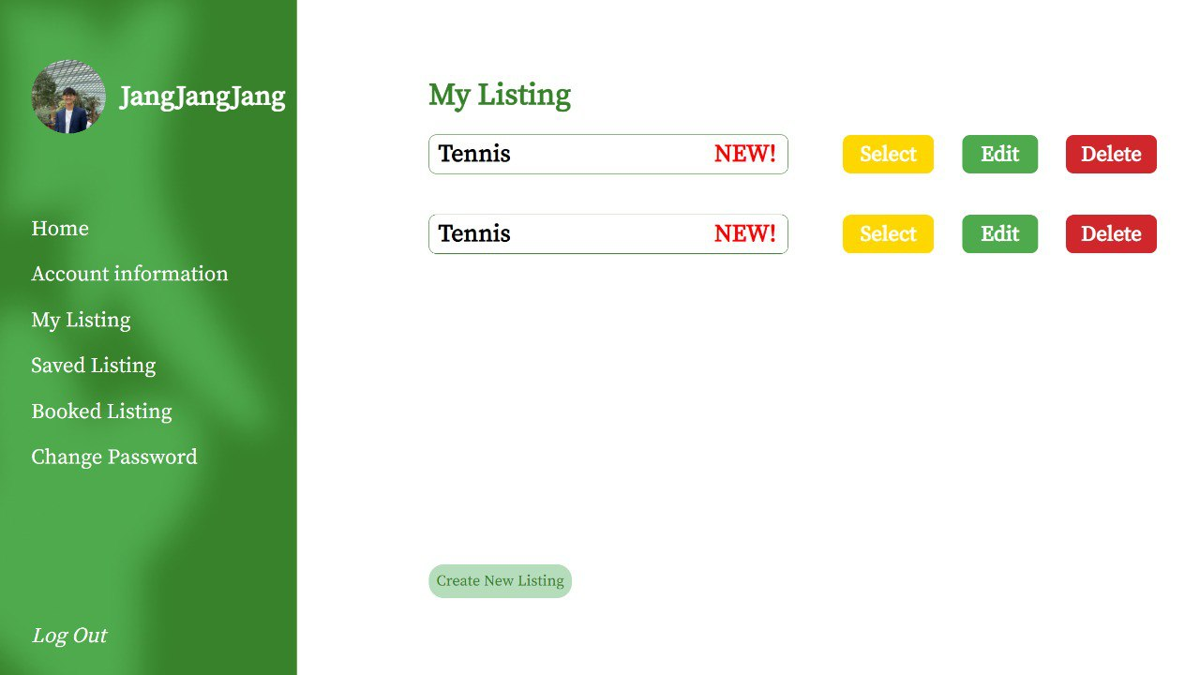
Observer Pattern

Slide 8
Object Design in Sportsync
Interface Specification: Operations, Arguments, Type Signatures, and Exceptions
Reuse: Existing Libraries and Design Patterns
Object Design
Restructuring: To Meet the Design Goal Maintainability, Flexibility
Optimization: Speed or Memory
Notes:
Allow me to explain our design principles now. Our website have incorporated 4 main object design principles. They are mainly, Interface Specification, Reuse, Restructuring and Optimization. Interface specification ensures clear communication and abstraction, facilitating well-defined contracts between components in our website. Reuse leverages existing code, enhancing efficiency and maintaining consistency across our system. Restructuring promotes maintainability by enabling code evolution and reducing errors through refactoring. Lastly, Optimization enhances performance and scalability, making software more efficient and adaptable to growing workloads. These principles collectively contribute to the development of high-quality, maintainable, and efficient software systems, benefiting both developers and end-users.

Slide 9
Design Patterns
Strategy Design
Factory Design
The Magic Power
Dynamic Loading
Notes:
Allow me to explain further, SportSync uses many design patterns that are thought in the lectures and out of lectures. First, we have incorporated Strategy Design, Factory Design and Dynamic Loading in our system to make it more robust and we call it the “THE MAGIC POWER”.

Slide 10
Sportsync Booking Framework
SportSync
Website
UIManager
views
ListingSystem
create
…
Chat ListingSystem
Book ListingSystem
Your ListingSystem
Strategy Design + Factory Design + Dynamic Loading
Notes:
Here is the snippet of our class diagrams of our listing system where we have incorporated the 3 design principles. Through this way we designing, we can create any subclass object without specifying the class name in the code, not needing to change a single line of code to use new classes and provide the foundation for modern software frameworks to load application-specific classes. In this way, we are encapsulating the object creation and making it easy to change object creation logic.

Slide 11
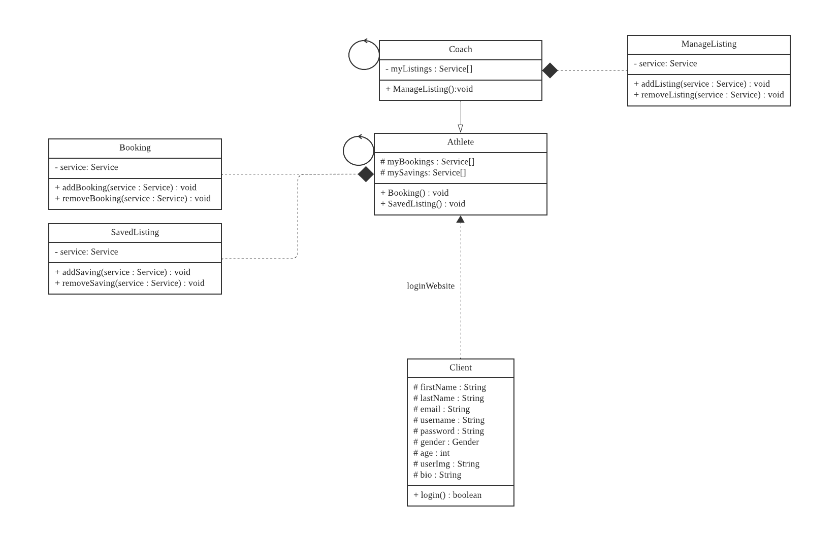
Façade Structural pattern
Makes code easier to use and understand
Reduces dependencies on classes
Decouples a client from a complex system
Notes:
Secondly, our website also make use of the Façade Structural Pattern. We design it such that it provides a unified interface to a set of interfaces in a subsystem. Façade defines a higher level interface that makes the subsystem easier to use. In this way, it makes the code easier to use and understand, reduces dependencies on classes and decouples a client from a complex system.

Slide 12

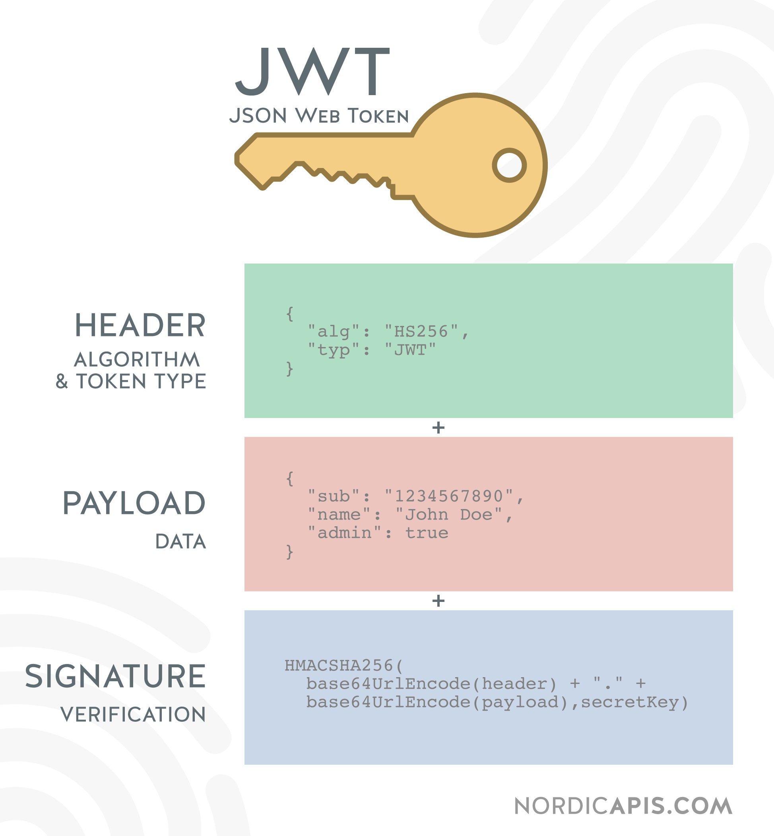
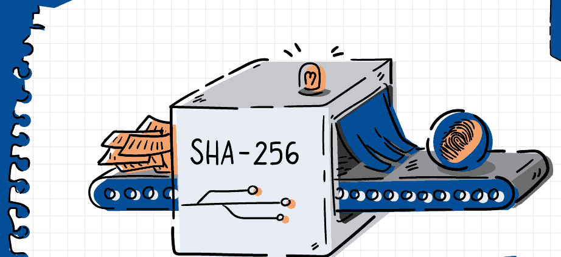
Thank You
Notes:
Therefore, Team 1 is extremely proud of our own project as we manage to incorporate the relevant design principles, Software Quality attributes and also added extra security features like json web token and SHA256 hashing of password. Not to mention that we manage to scale up higher by incorporating a ChatAPI and Booking of Taxi using our app which is not easy but we manage to do it in the end. So with that, Thank you for your kind attention!

